Slide 1
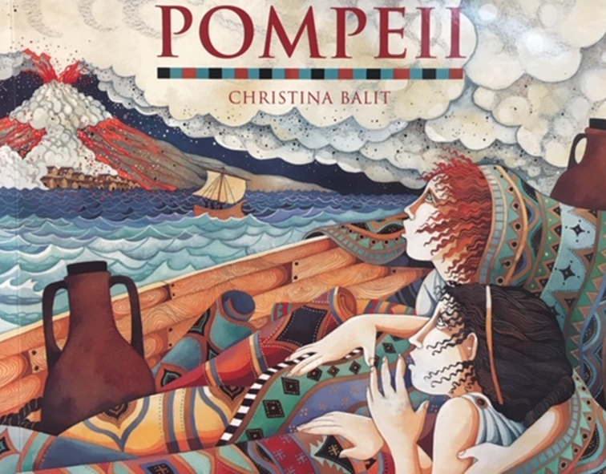
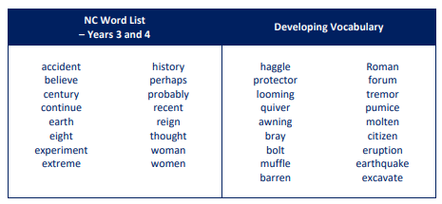
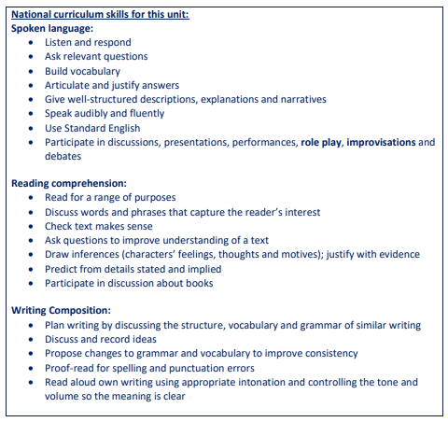
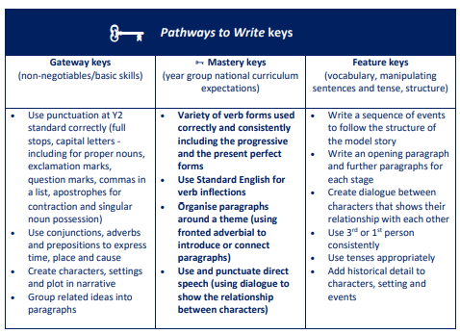
Writing outcome: To write from the point of
View of one of the children in the story.
Author:
Christina Balit
Historical fiction
Year 4 Crucial Knowledge Organiser - English
Guided Reading:

Slide 2
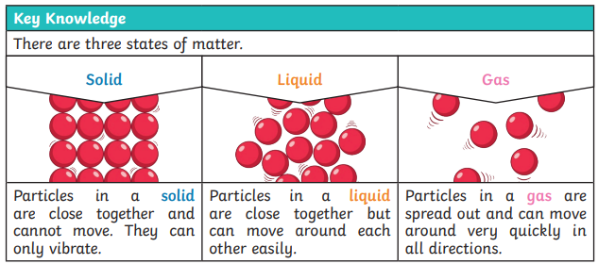
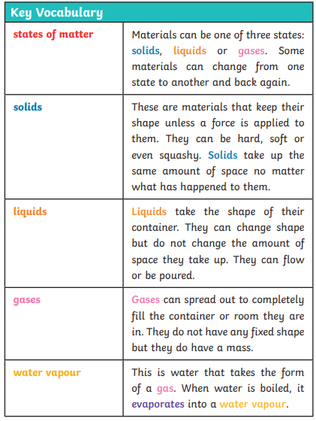
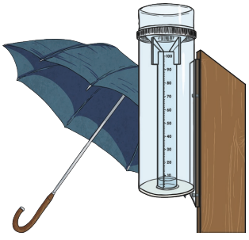
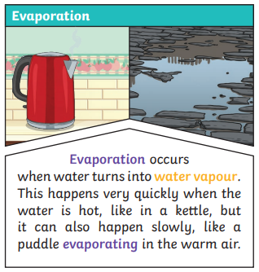
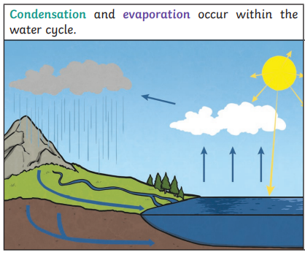
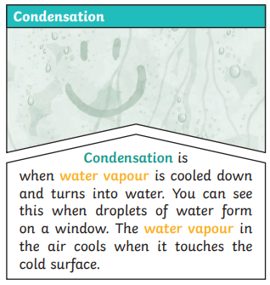
Spring 1: States of Matter
Year 4 Crucial Knowledge Organiser - Science

Slide 3
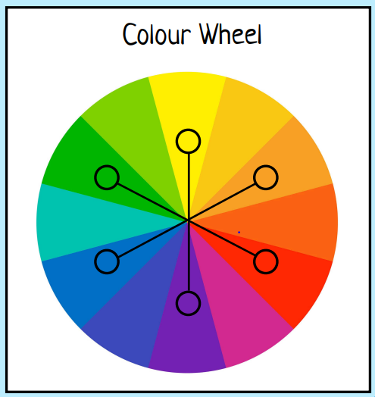
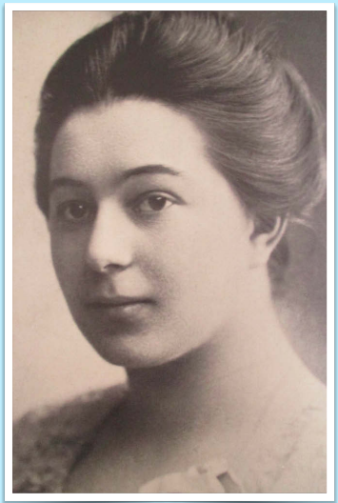
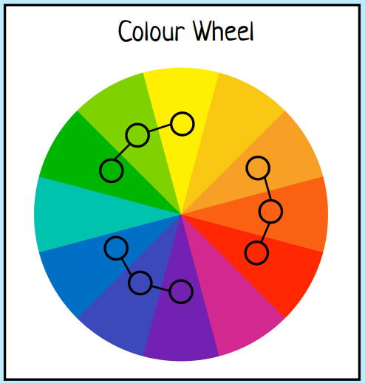
Spring 1: Sonia Delaunay
Sonia Delaunay was an artist from the Ukraine who has inspired a huge wave of artists. She began painting portraits between 1907-1908, but quickly became interested in abstract art.
She is best known for her work called ‘ORPHISM’ which is a type of art focused on using shapes, bright colours and light to try to create a sense of rhythm and movement.
Year 4 Crucial Knowledge Organiser - Art
Sonia Delaunay
(1885-1979)

