Slide 1
Saint Nathaniel’s Academy
Knowledge Organisers
Autumn Term Two
Year 3

Slide 2
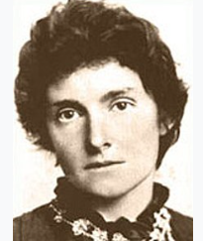
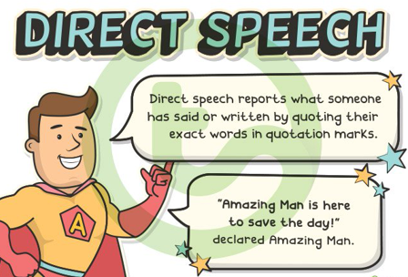
English Knowledge Organiser
Word Classes
Noun | a person, place or thing e.g. table
Adjective | describe a noun e.g tall table
Verb | a movement e.g. running
Adverb | gives more information about a verb e.g quickly running
Determiner | introduces a noun e.g The table
Proper noun | names a specific person or place e.g Miss Street
Autumn Term
YEAR 3
Edith Nesbit was an English author and poet who wrote over 40 children books.
Key Vocabulary and Spellings
Punctuation
quarry
scramble
children
outhouse
creature
Psammead
Robert
Cyril
Anthea
Jane
wishes
whisker
observed
buried
furry
astonishing
seashore
beautiful
Full stop | .
Capital letter | A B C …
Question mark | ?
Comma | ,
Inverted comma | “…..”
Exclamation mark | !

Slide 3
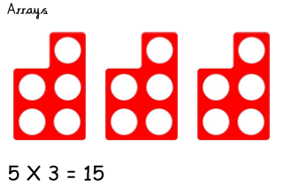
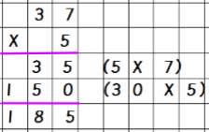
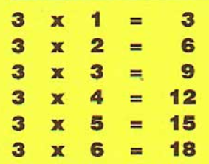
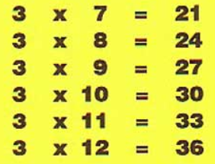
YEAR 3
Autumn Term
Maths – Knowledge Organiser
Multiplication
Multiplication
We will start the topic by consolidating multiplication through arrays and repeated addition.
After we will calculate multiplications by using a expanded column method.
E.G 37 X 5
Key Vocabulary
Multiply
Times
Groups of
Lots of
Product
Multiples of
Array
Multiplication – Counting in 3’s

Slide 4
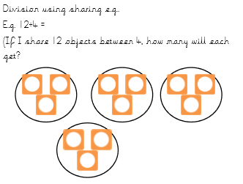
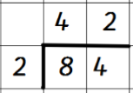
YEAR 3
Autumn Term
Maths – Knowledge Organiser
Division
We will start by consolidating methods used in previous years by using pictures and number lines. We then move to formal written method of short division.
Key Vocabulary
Equal groups of
Divide
Share
Shared Equally
Each
Evenly
Multiplication – Counting in 3’s

Slide 5
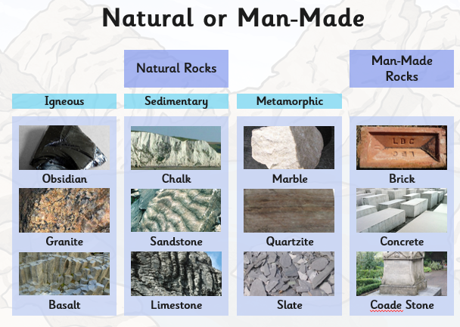
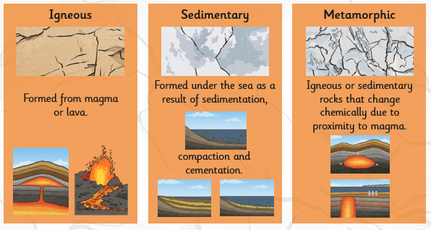
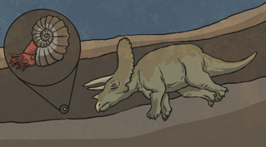
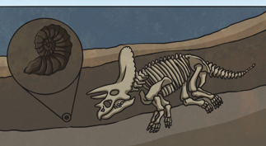
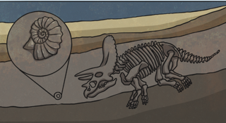
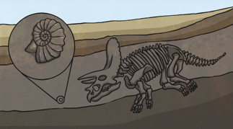
YEAR 3
Science Knowledge Organiser
Rocks
Autumn Term
Fossilisation process
1
2
Key vocabulary
Vocabulary | Definition
Permeable | Allows water to pass through.
Impermeable | Doesn’t allow water to pass through
Bones | Hard, white tissue that make up a skeleton.
Fossils | Body fossils are the remains of an animal or plant such as bones, shells or leaves
3
4

Slide 6
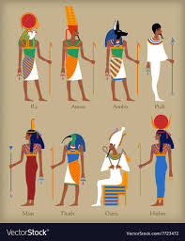
YEAR 3
Autumn Term
History Ancient Egyptians Knowledge Organiser
Key Vocabulary
Key Dates
Egyptian Gods
Egyptian writing - Hieroglyphics

Slide 7
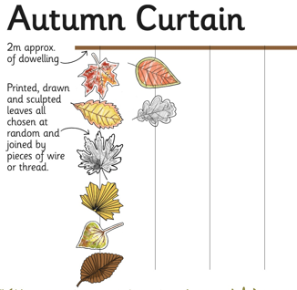
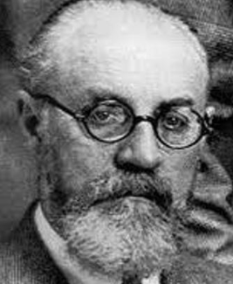
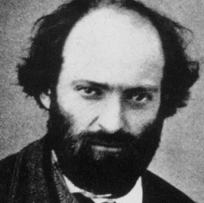
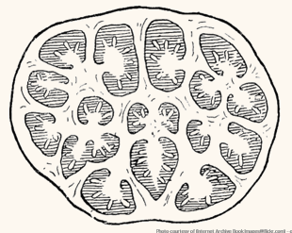
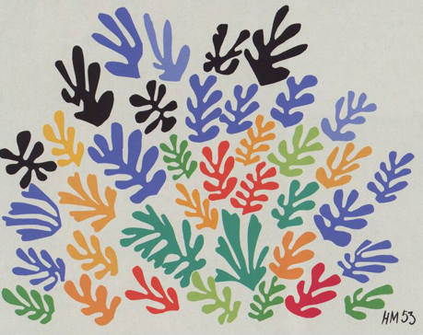
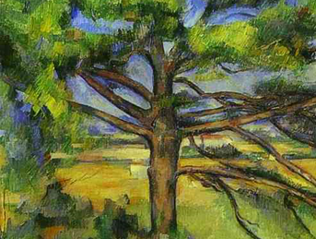
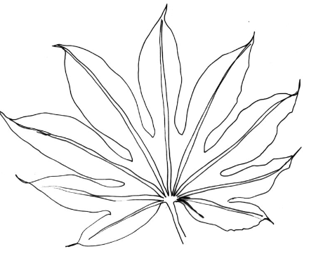
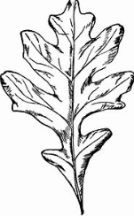
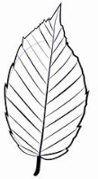
YEAR 3
Art Knowledge Organiser
Henri Matisse
Paul Cezanne
Cross section of a pumpkin
Key vocabulary | Definition
Line | A drawing done using only narrow lines, without blocks of shading.
Pattern | A repeated design that is used to decorate something.
Texture | Texture refers to the way an object feels to the touch or looks as it may feel if it were touched.
Observational drawing | Studying an object carefully and carefully drawing what you see.

Slide 8
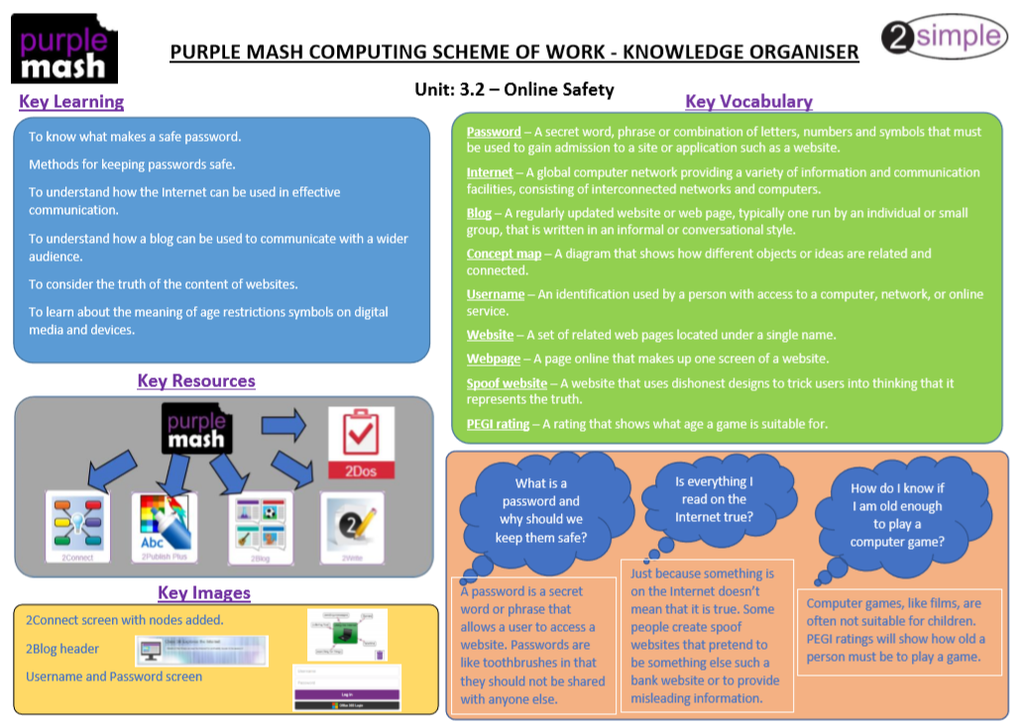
YEAR 3
Autumn Term
ICT – Knowledge Organiser

