Slide 1
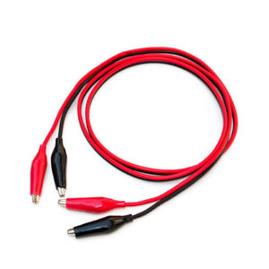
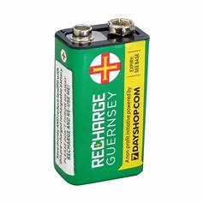
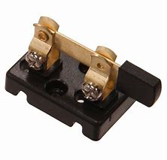
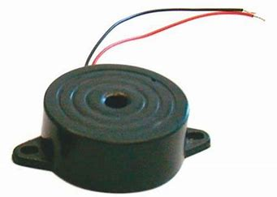
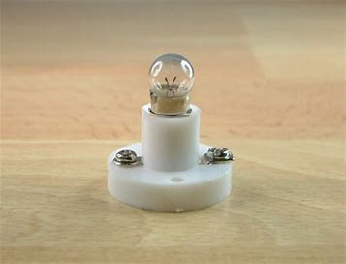
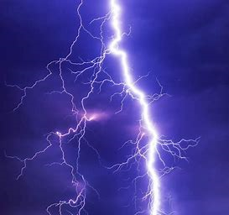
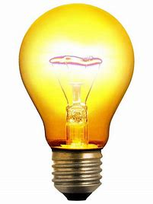
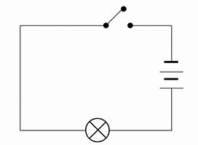
Science Knowledge Organiser – Electricity
Key vocabulary
circuit | A complete route which an electric current can flow around.
current | A flow of electricity through a wire.
battery | A small device that provides power for electric items.
cell | A device used to generate electricity. A battery is an example of a cell.
conductor | Any material that electricity can pass through or along.
insulator | Any material that electricity cannot pass through or along.
buzzer | An electrical device that makes a buzzing sound.
motor | A device that changes electrical energy into movement.
wire | A long thin piece of metal that carries an electrical current. They are often covered in plastic for safety.
Some components of an electrical circuit
 | wire | cell | switch | buzzer | lamp
Circuit Symbol
Picture
CAUTION
Common electrical hazards
Overloading a plug extension socket Exposed wires Damaged wall sockets Loose wires that people might trip over Placing metal into electrical appliances or sockets Electrical appliances near water
Electrical Conductors | Electrical Insulators
Copper Iron Steel Silver Gold | Rubber Wood Plastic Paper
A simple circuit

Slide 2
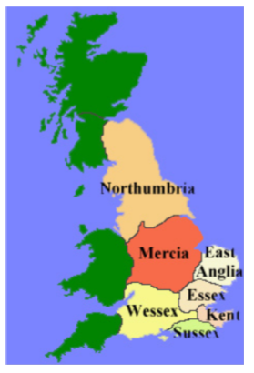
History Knowledge Organiser – Anglo Saxons and Scots
Timeline
410 CE | 449-450 CE | 516 CE | 570 CE | 597 CE | 600 CE | 613 CE | 731 CE | 757 CE | 789 CE
Last Romans leave Britain and the Picts begin to attack the Britons | Angles, Saxons and Jutes begin to settle Britain | Battle of Mount Badon – Between the Britons and the Anglo-Saxons | Heptarchy emerges in England | St Augustine brings Christianity to England from Rome | First Law Code written in English in Aethelbert’s kingdom in Kent | Northumbrian kings rule over most of England | Bede completes Ecclesiastical History of the English People | Offa becomes King of Mercia and arguably first king of all England | First recorded Viking attack (in Dorset)
Key People
St Augustine | Christian missionary considered responsible for lots of people converting to Christianity in Britain
King Aethelbert | King of Kent who created the first Germanic law code in the early 7th century
King Offa | King of Mercia, and most of England in the mid 8th century
King Arthur | Probably mythical King of Wessex, famous for stopping Saxon expansion.
Bede | Monk in Northumbrian monastery who wrote a history of the English church and people
Anglo-Saxon Gods
Balder | Immortality
Eostre | Birth and spring
Frigg | Love
Hel | Death
Lold | Cunning
Saxnot | Family
Thunor | Thunder
Tiw | War
Wade | Sea
Woden | Chief God
Key vocabulary
heptarchy | A collective name applied to seven Anglo-Saxon kingdoms. These were: Northumbria, Mercia, East Anglia, Essex, Kent, Sussex and Wessex.
ecclesiastical | Belonging to or connected with the Christian Church.
invasion | An attack on a country by an army.
runes | An ancient alphabet.
lyre | A small stringed instrument.
artefact | An object made by human beings.

Slide 3
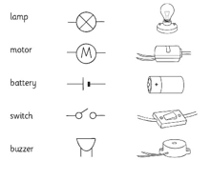
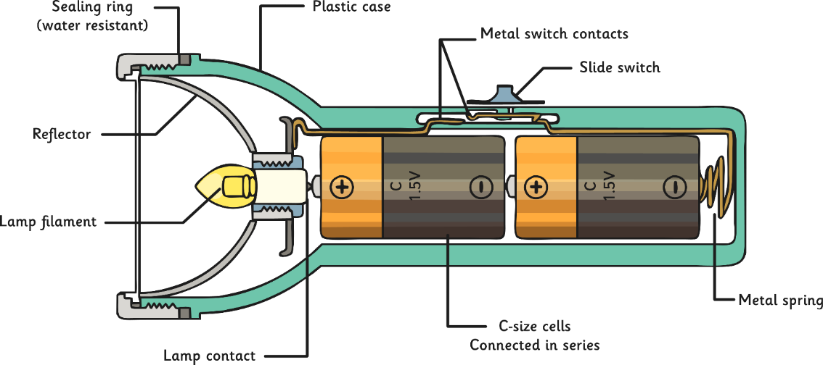
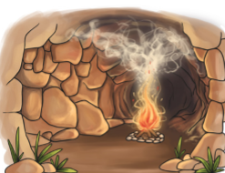
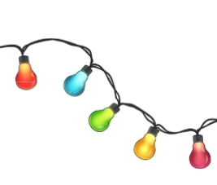
D&T Knowledge Organiser – Battery Operated Lights
Science
T Design & Technology
Engineering
Mathematics
Lighting over time
In the Paleolithic period, humans would build fires to give warmth and light. | In the Georgian period, candles would have been used to light up homes. | In the Victorian period, Thomas Edison invented the ‘modern day light bulb’. | LED lights are now more commonly used. They use up to 85% less energy and come in lots of different colour.
Key vocabulary
series circuit | In the series circuit the components are joined together in one bigger circuit (one continuous loop).
parallel circuit | Two smaller circuits with each bulb having it’s own circuit parallel to one another.
battery | A small device that provides power for electric items.
circuit | A complete route which an electric current can flow around.
switch | Competes a circuit, allowing an electric current to flow.

Slide 4
English Knowledge Organiser – Autumn 2
Our class book this term is ‘This Morning I Met a Whale’ by Michael Morpurgo.
Word Classes
Noun | a person, place or thing e.g. table
Adjective | describe a noun e.g tall table
Verb | a movement e.g. running
Adverb | gives more information about a verb e.g quickly running
Determiner | introduces a noun e.g The table
Proper noun | names a specific person or place e.g Miss Street
Key vocabulary & spellings
whale | A very large marine mammal.
mammal | A particular class of animal.
River Thames | A river which flows through the city of London.
London | Capital city of England, where the story is set.
stranded | Being stuck somewhere (eg in a river) with no way of getting out.
beached | A word usually used to describe a whale that has been washed up on a beach.
shallows | Parts of the water that aren’t deep such as at the edges of a river.
wallowing | To roll about or lie about in water.
hauled | To pull or drag something with force.
Punctuation
Full stop | .
Capital letter | A B C …
Question mark | ?
Comma | ,
Inverted comma | “…..”
Exclamation mark | !

Slide 5
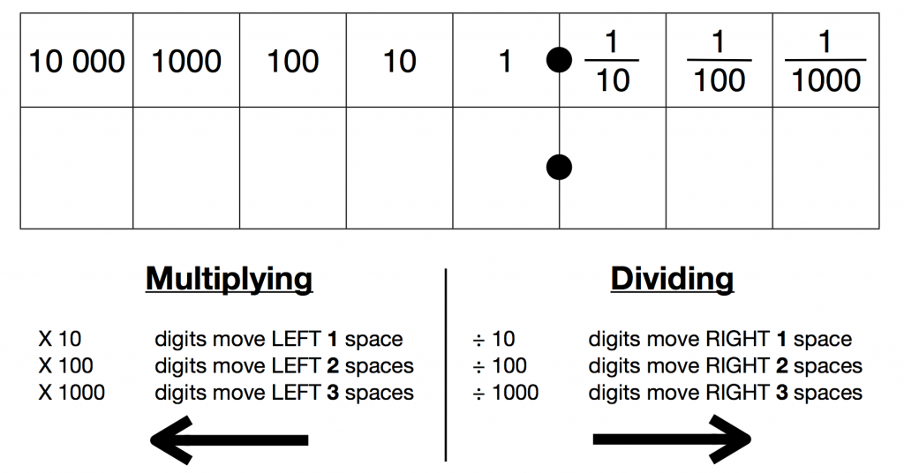
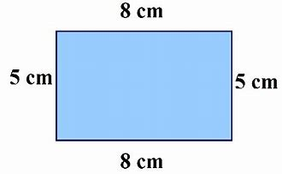
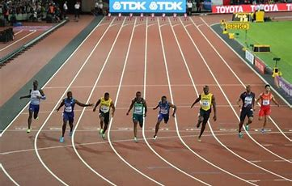
Maths Knowledge Organiser – Autumn 2
Perimeter
Multiplying and Dividing by 10, 100 and 1000
Multiplication and Division Facts
The perimeter of a shape is the total distance around the edge of the shape.
8 + 8 + 5 + 5 = 26cm
Key Vocabulary
Multiple— The product result of one number multiplied by another.
Division – Splitting a number into equal groups or parts.
Product — A result of multiplying numbers together e.g. the product of 6 & 3 is 18.
Perimeter - The perimeter of a shape is the total distance around the edge of the shape
1,000m = 1km
5,000m = 5km
10,000m = 10km
500m = ½ km
100m = 0.1km
Length
Anything that is multiplied by 0 is ALWAYS 0!
EG. 5 X 0 = 0
8 X 0 = 0

